Slide 1



No Way Out Escape Room Game
MLT Master’s Program – Language Technology – Dialogue Systems Course - LT2816 – Final Project

Slide 2
About the Game!
No way Out is an escape room dialogue-based game that challenges the player's memory and thinking skills.
The player has to go through 4 different rooms and solve 12 (in total) riddles, in order to get 4 code numbers. At the end the player needs to combine these numbers according to the correct order and place them in the right colored lock to win the game.
The purpose of this project is to establish the dialogue between the game and the player, but more importantly to work as a guide and as a co-player to whom the player can rely on.

Slide 3
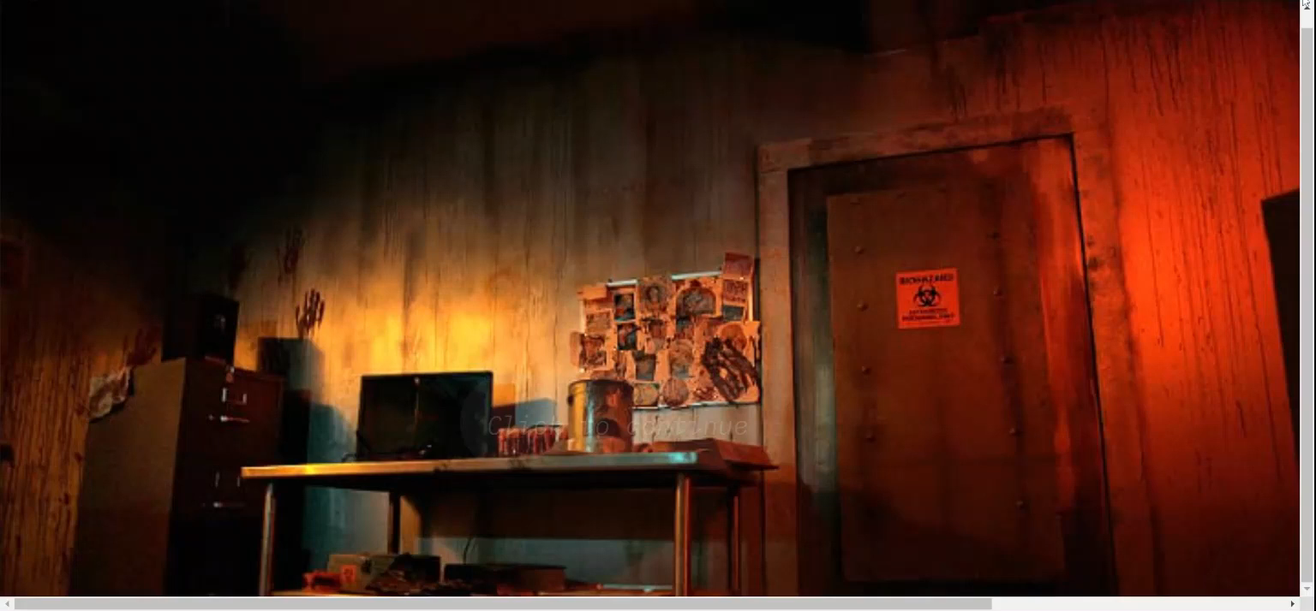
PRODUCT DEMO
Emphasis on:
Memory
Knowledge
System – Player Dialogue
Game Story
Hidden states

Slide 4
Technicalities
In order to create the game I used:
Base of the game:
The files in the forked repository (same Lab files)
Programming Languages:
TypeScript
TypeScript JSX (TSX)
TypeScript React
Xstate
Modifications on Html and CSS files
Image sources: https://www.artstation.com/artwork and google images
Artists: Tim Hertel, Om Bobon, Chris Riley

Slide 5


Challenges
Time
Experience

Slide 6

Relation to course contents
Most useful parts from the course:
Assignment from Lab 5: no input, history, prompt hierarchy
NLU resources from Lab 4 : Azure (intents) especially for out of context dialogue.
Statecharts
Difficulty levels = riddle answers
Voice only
Room Design
Ethical concerns future work (“free” dialogue)

Slide 7
Future work
My future work and ideas include additions like:
More rooms
Special visual and audio effects
More riddles
The opportunity for more dialogue-based conversation between the game character and the player
Movement (3d or 2d movement ability through the rooms)
Trophies, gainable items and difficulty levels
Triggering different speech states when clicking on objects

Slide 8
You can find my code and image files on my GitHub repository Escape Room: https://github.com/Elena-Giannitzi/EscapeRoom
You can find both the video of the demo and the presentation on my GitHub page.
Unfortunately, I haven’t solved the deployed app’s issue yet. The app still doesn’t show the images. I hope I can find a solution for it soon. Let me know if it’s needed as soon as possible.

Slide 9

THANK YOU!
DO YOU HAVE ANY QUESTIONS?

